Slide 1
Session 10: Monitoring and Controlling Projects
Dr Andre Samuel

Slide 2
Monitoring and Control Process

Slide 3
Monitoring and Control Overview
Different projects will use different means of monitoring and controlling - when in doubt, the simplest measure is usually best – usually % and actual spending.
The overall objective is to be able to respond to the following (simple) questions:
“Have we achieved the progress we expected to at this time?”
“Are we spending more or less than anticipated at this point?”
“Are we likely to complete on schedule and within the project budget?”
If necessary, decisive management action can then be triggered, e.g. project crashing additional resources, scope reduction etc.

Slide 4
Monitoring and control concepts
Project monitoring and control is a critical part of the project management process
Planning & controlling interlinked: control is the act of reducing the difference between the baseline plan and what actually happens in practice
Plans can never be perfect so monitoring and control activity is inevitable
Tracking and monitoring without control (intervention) is pointless?
The worse the planning process, the greater the need for controls?
Four steps:
Establish project baselines
Monitor and measure performance
Compare with baselines
Take corrective action, as necessary

Slide 5
Tracking/Control Step 1 - Establish project baselines
In effect, part of planning. Control needs planned benchmarks
Typical baselines include:
Cost (budgets),
Time (schedules),
Performance (specifications, quality plan).
Changes to baselines should only be made after review & approval using change control system
Baseline plans updated as authorised changes occur.
All appropriate stakeholders notified of authorised changes

Slide 6
Tracking/control Step 2 - Monitor & measure performance
Project progress measured regularly to identify variances from plan
Collect accurate information related to baselines, e.g.:
Percentage completion by task
Cost expended
Quality tests
Work scope change reports/requests
Timely collection of this data is critical and will be an ongoing activity throughout the duration of the project lifecycle

Slide 7
Tracking/control Step 3 – Compare with baselines
Contrast the actual performance against planned performance – develop a variance analysis
Formulation of regular (weekly?) progress reports and forecasts to completion
Apply selected tools - earned value, cash flow analysis, schedule appraisal.
Causes & effects analysed, reviewed and understood

Slide 8
Tracking/control Step 4 – Take corrective action if necessary
Once deviations are identified then corrective action, if necessary, is taken. The options available to the project manager include:
No action taken if the variances are small – within acceptable tolerances
Re-planning activities to recover the ambitions of the original plan
Revising the original plan in light of the current situation
In extreme situations terminating the project
Causes of change and reasons for selected corrective action should be documented

Slide 9
Managing Progress

Slide 10
Tracking – Gantt charts
Task
Task budget
Actual spend
Weeks
1
2
3
4
5
6
7
1
Design
80k
60k
The task is now 66% complete
Time Now
TimeNow (the time of assessment) is at the end of Week 4 (see vertical red line)
 How is the task progressing? Ahead or behind schedule?
 What is the financial position of the task?
Notes:
Notes: Task progress – poor. The red line shows that the task should be 80% complete at this stage (the plan). Based on 4 weeks work should have been done out of the five planned for the task. But the REALITY is only 66%. So 14% behind schedule – and it would now seem doubtful whether the task will in fact complete at the end of week 5 as planned.
Cost – also poor. The task has spent 75% of the budget available (60k spent, budget 80k) but only achieved 66% of the work. Not great and the project manager might worry whether the task will eventually exceed the budget of 80k. But there might be factors to explain this?

Slide 11
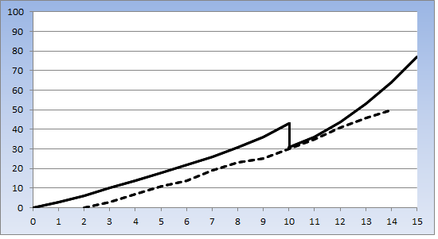
Progress S-curve
What is this showing? Good or bad news?
Time Now
%
planned (solid line)
actual (dashed line)
Timescale in weeks
Notes:
Notes - Actual project progress (dotted line) never matches planned progress (solid line). And in week 10 the project was REPLANNED with a new baseline. Sadly actual progress soon deviated again from the new plan. The dotted line stops at week 14 because that is TIMENOW (i.e. where we are currently on the project).

Slide 12
Projected spending
PM: Key Terms
It is often useful to be able to calculate the projected spending on a task based on actual progress and actual spending so far:
The formula is:
projected spending =
100
X
actual spending
actual % progress
Provided to you

Slide 13
Projected spending - example
A project task is reported as being 40% complete and has spent £35,000 so far. The task budget is £75,000 and the project manager is concerned whether the budget will be exceeded.
According to the formula:
 Is this definitely going to be a financial problem?
100
projected spending =
X
35,000
40
projected spending = £87,500

Slide 14
Assess overall progress on the railway project
How would you calculate the progress? – There are 3 ways of looking at it….
40%
50%
28%
Explain how the three options were calculated
 Which would you chose?
Notes:
a) 40% = 100 + 20/300
b) 50% = 72km + (0.2 * 40km) = 80 km Total km is 72 + 40 + 48 = 160 km 80/160 = 50%
c) 28% = 24 weeks + (0.2 *20 weeks) = 28 weeks Total weeks = 20 + 24 + 56 = 100 weeks 28/100 = 28%

Slide 15
Does knowing the budget cost make any difference?
What is progress based on cost?
Budget cost
$4m
Budget cost
$3m
Budget cost
$3m

Slide 16
Consider cost
 What is progress based on cost?
$4m spent
$3m X 0.2 = $600k
4.6k spent = 46%
Budget cost
$4m
Budget cost
$3m
Budget cost
$3m

Slide 17
Managing Progress/Tracking - summary
Different projects will use different means of tracking - when in doubt, the simplest measure is usually best – usually % and actual spending.
The overall objective is to be able to respond to the following (simple) questions:
“Have we achieved the progress we expected to at this time?”
“Are we spending more or less than anticipated at this point?”
“Are we likely to complete on schedule and within the project budget?”
If necessary, decisive management action can then be triggered – see acceleration handout

Slide 18
Project Crashing

Slide 19
Project Crashing
Time
Quality
Cost
Scope
“Crashing”
reducing project time by expending additional resources – typically people
Crash time
an amount of time that a task duration may be reduced
Crash cost
The cost of reducing each task duration
Goals
To reduce project duration at minimum cost
And/or to seek a preferable solution

Slide 20
Time-Cost Relationship
Crashing costs generally increase as the project duration decreases (more time being saved)
Indirect/overhead costs relating to time increase as project duration increases
The objective is to reduce project length as long as crashing costs are less than the increase in indirect costs
How best to do this?

Slide 21
Time-Cost Tradeoff
Minimum cost = optimal project time
Total project cost
Indirect cost
Cost ($)
Direct cost
Crashing Time
Project duration

Slide 22
Project Crashing: Example
Identify: the critical path project duration
Task 2
4 weeks
Task 4
12 weeks
Task 1
12 weeks
Task 7
4 weeks
Task 3
8 weeks
Task 5
4 weeks
Task 6
4 weeks

Slide 23
Crashing strategies
Prioritise those tasks on the critical path
Saving time on these tasks should reduce the overall project duration
Re-model the critical path
Check for any NEW critical paths
Recalculate the new overall budget
And compare with the original schedule and budget combination
Assess any other opportunities for fine-tuning?

Slide 24
Project Crashing: Example of options
Note the crash options and identify: the new critical path new project duration
Task 2
4 weeks
Task 4
6 weeks
(was 12)
Task 1
8 weeks (was 12)
Task 7
4 weeks
Task 3
4 weeks
(was 8)
Task 5
4 weeks
Task 6
4 weeks

Slide 25
Crashing approach: recap
Perform the basic critical path analysis
Calculate the first cost budget – and double check
Carefully consider the crash options available
Prioritize the critical path tasks to search for immediate time savings
Recalculate the budget to compare the cost impact between direct and indirect costs
Double check to see if any other opportunities have been missed

Slide 26
Monitoring and Controlling Processes: Summary
Monitoring &
Controlling Processes
Monitoring &
Controlling Processes
Integrated Planning
Project Start Up
Project Close
Managing Deployment
There are different approaches to monitoring and controlling – often % complete and actual spending.
Monitoring and controlling is assessing: progress, budget and time
If necessary, decisive management action can then be triggered, e.g. project crashing, additional resources, scope reduction etc.

Slide 27
Relationship between Planning and Control

Slide 28
Relationship between Planning and Control
Project Management Process Groups. PMI (2013, pg. 50)

Slide 29
The integrative nature of project management requires the Monitoring and Controlling Process Group to interact with the other Process Groups
Monitoring and Controlling processes occur at the same time as processes contained within other Process Groups.
Thus, the Monitoring and Controlling Process is pictured as a “background” Process Group for the other four Process Groups

Slide 30
The Planning processes develop the project management plan and the project documents that will be used to carry out the project.
The project management plan and project documents developed will explore all aspects of the scope, time, cost, quality, communications, human resources, risks, procurements, and stakeholder engagement
The Project management plan serves as the input into the Monitoring and control process

Slide 31
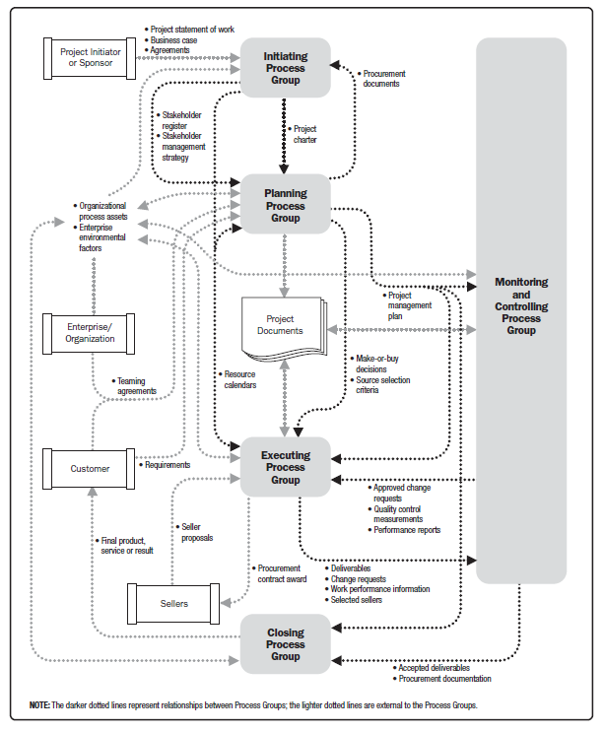
Project Management Process Interactions (PMI 2016)

Slide 32
Updates arising from approved changes during the project generally during Monitoring and Controlling may significantly impact parts of the project management plan and the project documents.
Updates to these documents provide greater precision with respect to schedule, costs, and resource requirements to meet the defined project scope
In other words the output of Monitoring and Control during the project serves as the input to each planning iteration

Slide 33
The monitoring and control process is applied to that end and has two objectives:
to ensure that the plan is followed
to ensure the plan remains credible
Simpsons (2010)
Without control all the planning is fruitless because control consists of the steps taken to ensure that the performance of the organization conforms to the plans.
In other words control is concerned with the actual performance in relation to the standards set in advance and the correction of deviations to ensure attainment of objectives.
Planning is required at the very outset of management whereas control is required at the last stages.

Slide 34
Key Points
Planning & controlling interlinked: control is the act of reducing the difference between plan and reality
Plans can never be perfect so control is inevitable
Control identifies changes to plan that may require re-planning

Slide 35
Issue Management

Slide 36
Implement Responses Risks and Issues
Risk "An uncertain event or condition that, if occurs, has a positive or negative effect on one or more project objectives.” (PMI, 2021, p. 53, 117, 122 and 248)
⬇
Issue: “A current condition or situation that may have an impact on the project objectives” (PMI, 2021, p. 185 and 241)
Managed in a similar way….

Slide 37
Issues management
Identification
Resolve and Close
Record in Issues Register / Log
Yes / No Take action to
address the
issue
Monitor / Report
Escalate

Slide 38
Issues Log/Register
Issue log “is used to record and monitor information on active issues” (PMI, 2021, p. 185 and p.241)
All logged, example:
Issue ID | Issue Description | Date Raised | Actions | Owner | Status | Date Closed

Slide 39
Threat Strategies (PMI, 2021, p.123)
STRATEGY | DEFINITION
ESCALATE: | Escalation is appropriate when the project team or project sponsor agrees that a threat is outside the scope of the project or that the proposed response would exceed the project manager's authority.
AVOID: | When the project team acts to eliminate the threat or protect the project from its impact.
TRANSFER: | Transfer involves shifting ownership of a threat to a third party to manage the risk and to bear the impact if the threat occurs.
MITIGATE: | Action is taken to reduce the probability of occurrence and/or the impact of a threat. Early mitigation is usually more effective.
ACCEPT: | Acknowledge the existence of a threat, but no proactive action is taken.
Notes:
Escalate - Escalate to program level, portfolio level or other relevant part of the organisation.
Change the project plan or objectives, isolate the project objectives fro risk's impact, e.g. extend schedule, change strategy, reduce scope.
Responses to managing risks can generally be categorised as follows:
Tolerate – accept the risk without any immediate action
Treat – implement actions to reduce the impact and/or probability of risk occuring
Terminate – completely cease any project activities that could result in the risk
Transfer – transfer the risk to another party e.g. insurance policies, contractors
Take the risk – implies a positive risk where the rewards are considered to be worth the risk
Terminology
Contingency – Is the planned allotment of time and cost or other resources for unforeseeable risks within a project.
Contingency Plan – Alternative course(s) of action to cope with project risks or if expected results fail to materialise.
The selected response to a risk and whether contingency is needed will depend on a number of factors.

Slide 40
V Hawk project
Task | Description | Duration
A | Systems Analysis & Design | 5 days
B | Buyer Interface Design | 9 days
C | Buyer database configuration | 22 days
D | Supplier database configuration | 17 days
E | Load supplier data records | 7 days
F | Test and implementation | 10 days
‘Web marketplace’ for a Middle-East government client provisionally called ‘V-Hawk’.
Project Manager: Malik Al-Sulari
IT consultant: Pat O’Hara
Project Schedule
Duration: 46 working days
Critical path in red: A, B, C, F
Project Team
Paula Jiggins – a database administrator
Ranjeev Vastal – a web site developer
Cost of project team: £500 per day worked plus all their travel and hotel expenses.
B 9
C 22
A 5
F 10
D 17
E 7

Slide 41
Issue: Resource Skills
Paula Jiggins reviewed the project plan and made the following comment:
“The task durations are realistic Malik, but you seem to have overlooked who does what.
Basically only I (Paula Jiggins) can do tasks D and C, and only Ranjeev Vastal can do task B.
Either of us could do Task E alone but tasks A and F must be worked on by both of us.”

Slide 42
Issue occurred: Resource skills effecting tasks in parallel Timing Effected
Add the resources to your table:
Task | Description | Duration | Predecessor | Resources
A | Systems Analysis & Design | 5 days |  | Ranjeev Vastal and Paula Jiggins
B | Buyer Interface Design | 9 days | A | Ranjeev Vastal
C | Buyer database configuration | 22 days | B | Paula Jiggins
D | Supplier database configuration | 17 days | A | Paula Jiggins
E | Load supplier data records | 7 days | D | RV or PJ
F | Test and implementation | 10 days | C, E | Ranjeev Vastal and Paula Jiggins

Slide 43
Identify what is causing the bottleneck
What is the constraint?
What is slowing the project down?
Is it the Critical path?
Is it a resource constraints: availability, skills, etc.?
Is it an immovable dates?
Is it psychological and/or cultural aspects – behaviours, practices, customs?
Bottleneck

Slide 44
For V-Hawk – at this point – it is resource constraints
What is slowing the project down?
Critical path
Resource constraints: availability, skills, etc.
Immovable dates
Psychological and/or cultural aspects – behaviours, practices, customs
Bottleneck

Slide 45
Issue occurred: Not enough resource Timing Effected
What happens to the duration?
Where is the constraint happening (Bottleneck)?
B 9
RV
C 22
PJ
A 5
RV&PJ
F 10
RV&PJ
D 17
PJ
E 7
RV or PJ

Slide 46
ANSWER - Issue occurred: Not enough resource Timing Effected
Critical Chain here – bottleneck is Paula Jiggins
54 days [was 46 days]
B 9
RV
C 22
PJ
A 5
RV & PJ
F 10
RV & PJ
D 17
PJ
E 7
RV
Paula Jiggins is the bottleneck – assign task to Ranjeev Vastal

Slide 47
Al-Sulari’s Budget Calculation
Cost: £500 per day worked plus all their travel and hotel expenses.
Malik Al-Sulari had calculated £35,000 excluding travel and hotel expenses….
1 IT consultant working 46 days [A,B,C,F) = £23,000
An additional IT consultant working 24 days (D,E) = £12,000
B 9
£4,500
C 22
£11,000
A 5
£2,500
F 10
£5000
D 17
£8,500
E 7
£3,500

Slide 48
What happens to your budget?
Cost: £500 per day worked plus all their travel and hotel expenses.
B 9
RV
C 22
PJ
A 5
RV & PJ
F 10
RV & PJ
D 17
PJ
E 7
RV

Slide 49
ANSWER: What happens to the budget?
Cost: £500 per day worked plus all their travel and hotel expenses.
Ranjeev Vastal = A, B, E and F = (5+9+7+10) * 500 = £15,500
Paula Jiggins = A, D, C and F = (5+17+22+10) * 500 = £27,000
= £42,500 [was £35,000]
B 9
RV
C 22
PJ
A 5
RV & PJ
F 10
RV & PJ
D 17
PJ
E 7
RV

Slide 50
So, the project is now 54 days and costing £42,500
The issue has results in the project quickly becoming 8 days longer and £7,500 more expensive….
 Discuss: What do you do now you have all this information? (PMI, 2021, p.123)
STRATEGY | DEFINITION
ESCALATE: | Escalation is appropriate when the project team or project sponsor agrees that a threat is outside the scope of the project or that the proposed response would exceed the project manager's authority.
AVOID: | When the project team acts to eliminate the threat or protect the project from its impact.
TRANSFER: | Transfer involves shifting ownership of a threat to a third party to manage the risk and to bear the impact if the threat occurs.
MITIGATE: | Action is taken to reduce the probability of occurrence and/or the impact of a threat. Early mitigation is usually more effective.
ACCEPT: | Acknowledge the existence of a threat, but no proactive action is taken.

Slide 51
Any questions
?
?
?
?
?
?
?

